Slide 1
LOGIC MODELS
By
Hilarie B. Davis, Ed.D. & Bradford T. Davey, Ed.D.
Technology for Learning Consortium Inc.
March 2013
hilarie@techforlearning.org brad@techforlearning.org

Slide 2
Objective: To understand the purpose and format of each component of a logic model.
Essential Question: How do you use a logic model to capture how your project will achieve results?

Slide 3
Where’s the logic in that?
Logic is core to our acceptance of ideas. We expect things to make sense
When a project makes sense to stakeholders, they are more likely to contribute to the outcomes in explicit and implicit ways
A logic model makes the connection clear between what you invest, what you do, and what impact you have
Creating a logic model gets everyone on the same page

Slide 4
Origins of the logic model
Systems theory attempted to capture the relationships in mechanical and industrial systems to improve efficiency of design and maximize success (Jay Forrester)
When applied to social science situations, this systems thinking proved to be useful for understanding relationships in a situation and why delays or breakdowns occurred (Peter Senge)
Current logic models take a variety of forms, and are more or less complex (Kellogg Foundation)

Slide 5
Buying a House Logic Model
INPUTS
OUTPUTS
OUTCOMES
Buyer’s needs
Buyer’s wants
Budget
Listings
Downpayment
Drive bys to narrow search
Showings on potential homes
Loan approval
Make offer
Close
Move
Settle in
Entertain
Live happily ever after

Slide 6
A logic model shows…
What matters
What you believe – your assumptions
What you are investing
What you will do and with whom
What you expect the impact will be
Your theory of change – the if-then connections

Slide 7
Vacation Logic Model
INPUTS
OUTPUTS
OUTCOMES
Travelers’ bucket list
Budget
Tour books
Other’s experiences/reviews
Adventure!
Memories
Education
Appreciation for another place
Narrow options
Book it
Pack
Go!

Slide 8
Theory of Change Your hypothesis
Your Theory of Change states why you believe what you are doing will have the outcomes you expect
For example, Having scientists communicate about current research along with resources and activities engages the public, teachers, and students in learning and ignites their curiosity

Slide 9
A logic model is used to…
Make explicit to your own team what you think will happen
Show your theory of change
Show the relationships of what you will invest, what you will do and what results your expect
Communicate with others about your work
Guide the project – refer back to it
Report on the project – show revisions, provide evidence for if-then connections

Slide 10
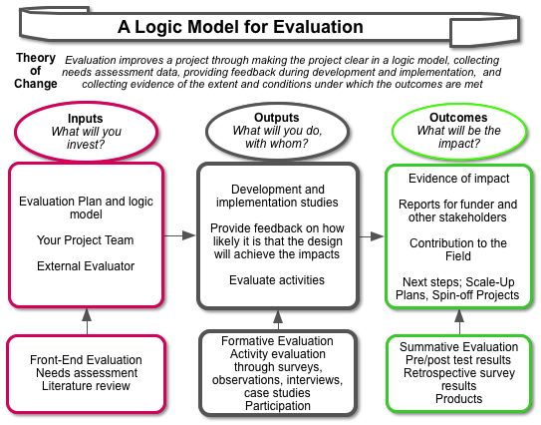

Slide 11
Inputs What will you invest?
Invest is from the Latin, to “clothe” and means to furnish with power or authority, to endow with a quality, to make use of for future benefits or advantages, or to involve or engage especially emotionally
Under inputs list the resources you will need to achieve your outcomes, including people, institutions, resources, and events
Briefly state the contribution of each investment, e.g., the science center will offer programs for the public, the faculty will contribute content expertise

Slide 12
Outputs What will you do with whom?
Outputs are the activities you do, such as offer professional development, create products, organize resources on the web, or offer learning experience for students
State the activity with the expected audience, e.g., professional development on current astrobiology research in Yellowstone for 120 middle and high school teachers from throughout the state for 3 summer days, and 2 follow up days

Slide 13
Outcomes What is the impact of your work?
Outcomes are the impact of the activities on the audiences
Describe the impacts on each audience in terms of things like the NSF impact categories - behaviors, attitudes, skills, interest and knowledge (BASIK)
For example – Middle and High school teachers are prepared to integrate astrobiology content and resources into their curricula

Slide 14
Practice
Bobby McFerrin Plays the Audience
http://www.ted.com/talks/bobby_mcferrin_hacks_your_brain_with_music.html
As you watch the video, think about:
What did it take to do this activity? (inputs)
What was the activity? With whom? (outputs)
What was the impact? (outcomes)
What is his theory of change?

Slide 15
Reflect
Reflect using the essential question:
How do you use a logic model to capture how your project will achieve results?

Slide 16
Apply
Choose something you are working on to create a logic model
Think about what you are investing? (inputs)
What are the outputs for what audiences?
What outcomes/impacts do you expect?
What is your theory of change?

Slide 17
For more on logic models
Examples http://www.uwex.edu/ces/pdande/evaluation/evallogicmodelexamples.html
Interesting visual formatshttp://ctb.ku.edu/en/tablecontents/sub_section_examples_1877.aspx
Practice developing a logic model https://apps.publichealth.arizona.edu/CHWToolkit/PDFs/Logicmod/chapter2.pdf
Kellogg Foundation http://www.wkkf.org/knowledge-center/resources/2006/02/wk-kellogg-foundation-logic-model-development-guide.aspx

